Slide 1

Human resources slide 1
Database Management System for University (U.D.B.M.S)
Prepared By: Ahmed Hatem Ghazy

Slide 2
Human resources slide 2
AGENDA
Overview
Database Design
SQL Implementation
PLSQL Implementation
Bash Scripting
Java Application

Slide 3

Human resources slide 3
Data Organization and Storage
User-Friendly
THE
Efficient Management
Data Retrieval and Manipulation
U.D.B.M.S
Reports Generation
Data Integrity
Scalability and Performance

Slide 4
Human resources slide 4
DATABASE DESIGN
ENTITY RELATIONSHIP DIAGRAM
COURSES
DEPARTMENTS
STUDENTS
EVALUATIONS

Slide 5
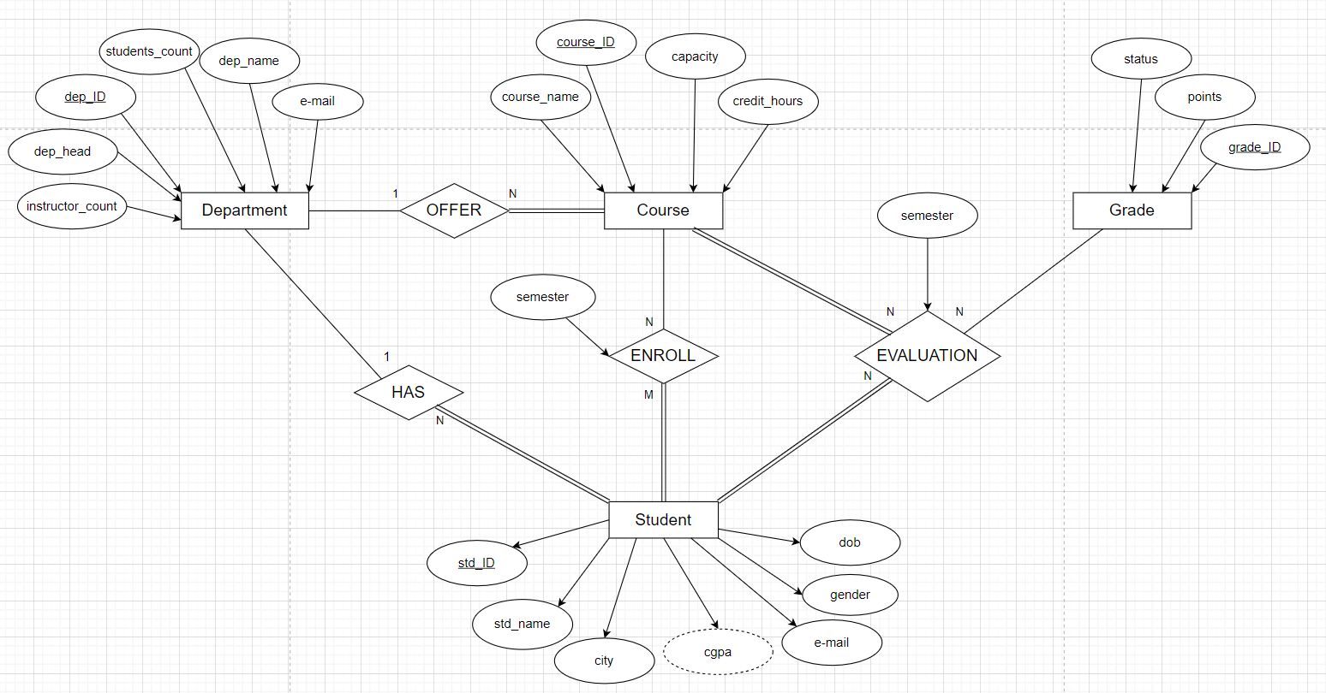
Human resources slide 5

Slide 6

Human resources slide 7
PLSQL SCRIPTS
CALCULATE AVERAGE COURSE GPA FUNCTION
EVALUATION TRIGGER
UPDATE EVALUATION AND CGPA PROCEDURE
This procedure updates a student's grade for a specific course and semester, recalculating their Cumulative Grade Point Average (CGPA) accordingly.
This function computes the average GPA for a specified course in the university database system.
This trigger automates the process of enrolling a student into the evaluation system when they are enrolled in a course.

Slide 7
Human resources slide 7
PLSQL SCRIPTS
GENERATE EVALUATION DATE TRIGGER
DELETION TRIGGERS
UNENROLL STUDENTS TRIGGER
This trigger manages the unenrollment of a student from a course in the university database and triggered before the deletion of an evaluation record.
This trigger generates a random evaluation date based on the semester before inserting a new entry into the evaluation table.
This trigger handles the deletion of student data, course data and department data from the university database.

Slide 8
Human resources slide 8
Bash Scripting
TNSNAMES
BACKUP SCRIPT
This script is designed to perform automated backups of an Oracle database using Oracle Data Pump. It exports data from the specified database and saves it to a backup file in a designated directory. Additionally, it logs the outcome of the backup operation for tracking and monitoring purposes.
EXPDP
EXPDP
COMMAND FOR DATA EXPORTING
.dmp and
.log files
.dmp and .log files
.dmp FILE FOR DATA and .log FILE FOR PROCESSES

Slide 9
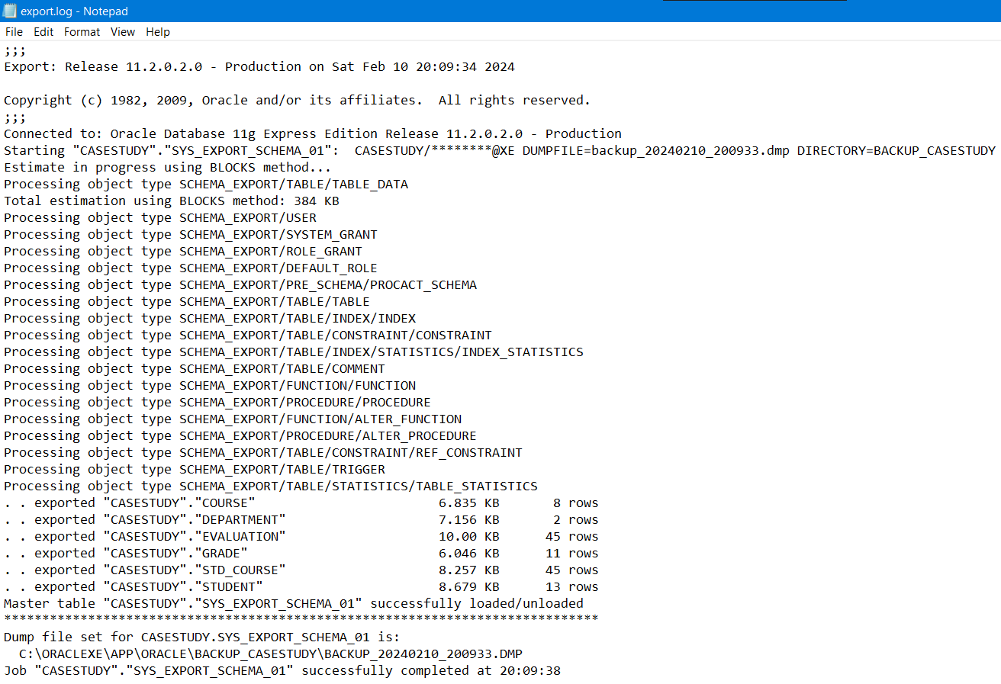


Slide 10
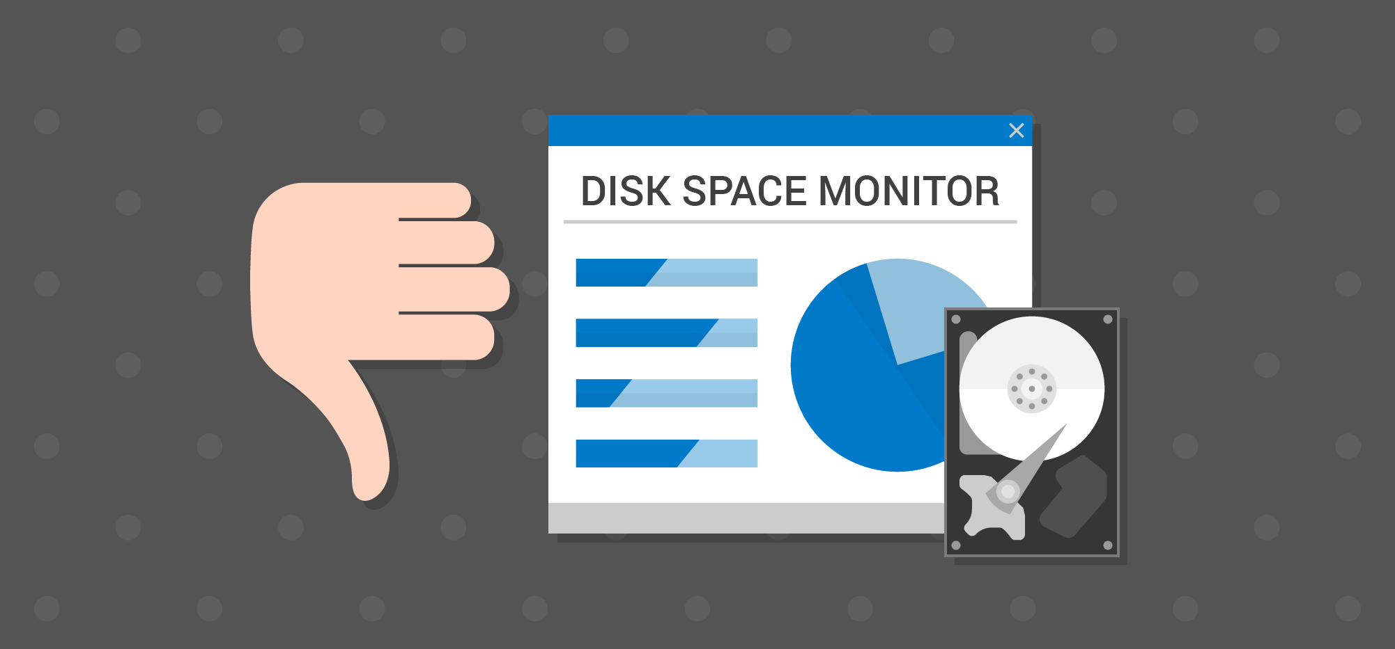
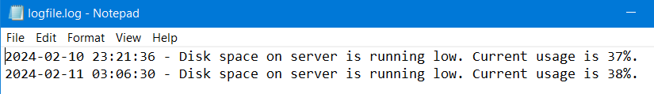
Disk Space Monitoring
This Bash script monitors disk space usage on a Windows system. It leverages the Windows Management Instrumentation Command-line (WMIC) to gather disk space information from the C: drive. If the disk space usage exceeds a specified threshold, the script writes an alert message to a log file.

Slide 11
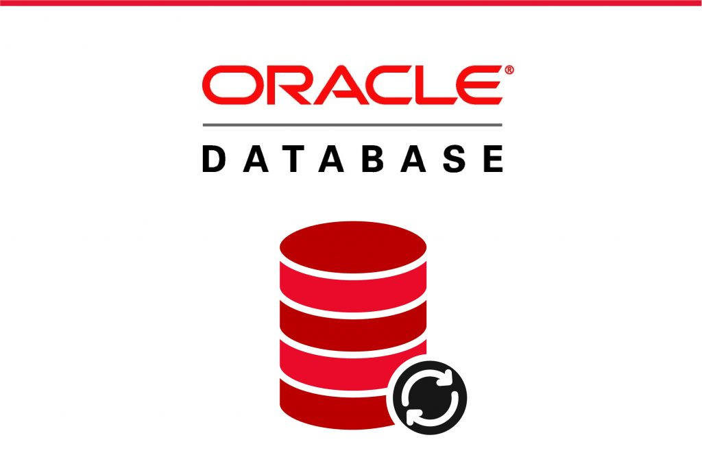
Human resources slide 9
Java Application
The Development Architecture
Database Connection using Oracle 11g
Data Transfer Objects (DTOs)
The Controllers
The Application Scenes

Slide 12
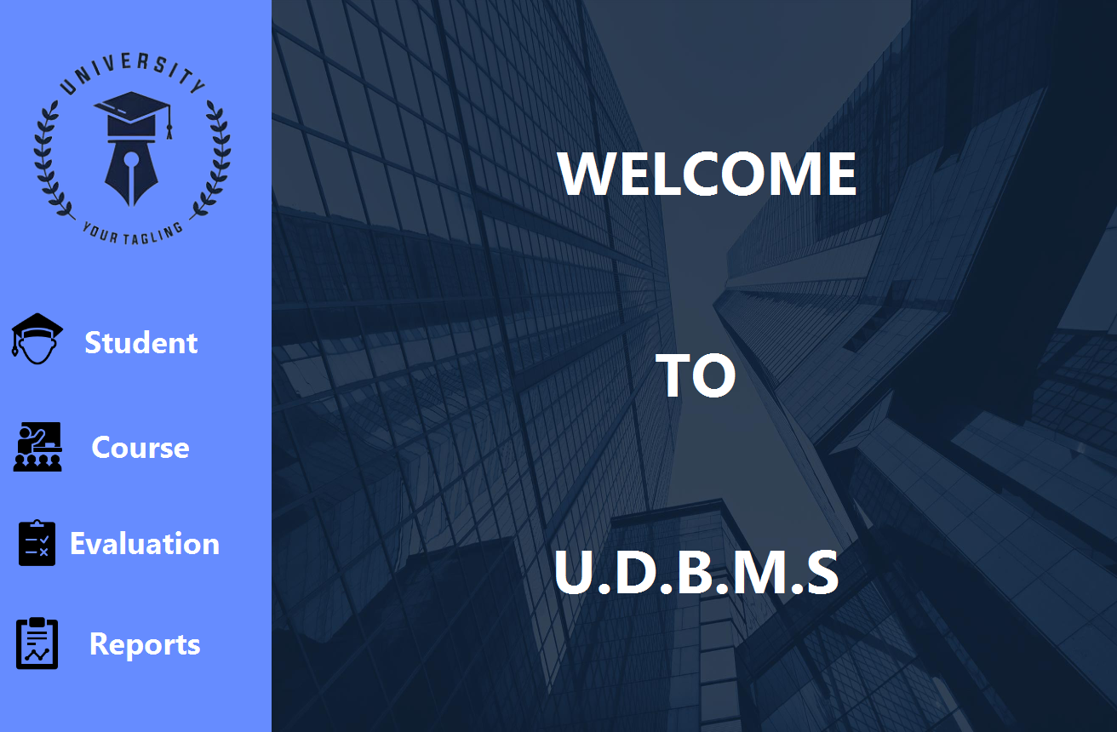

Slide 13
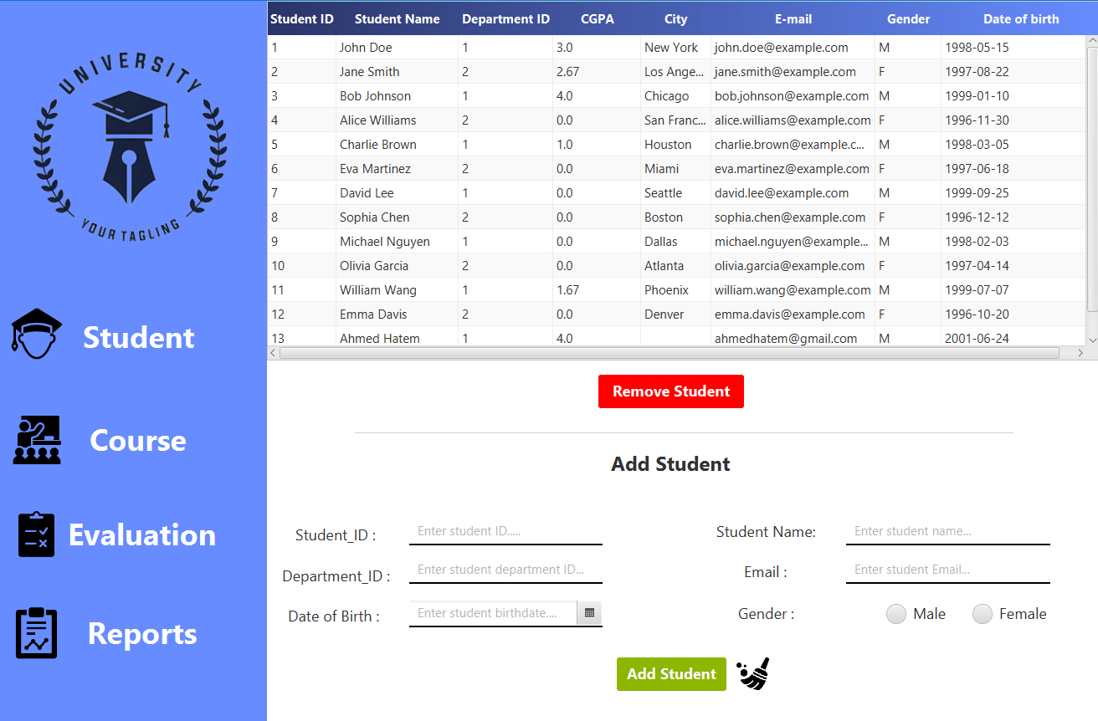

Slide 14
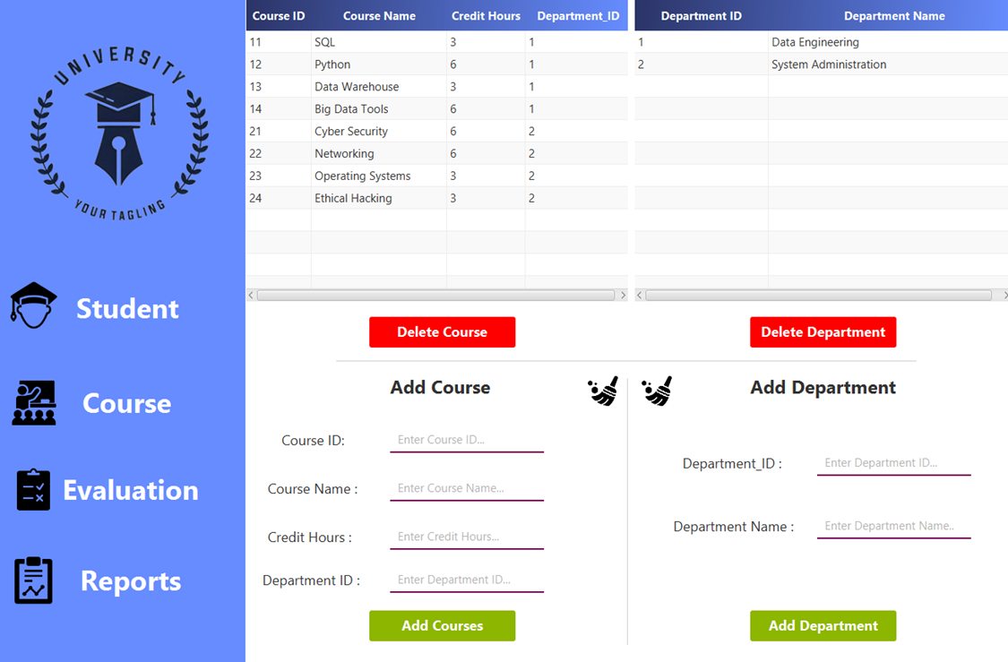

Slide 15
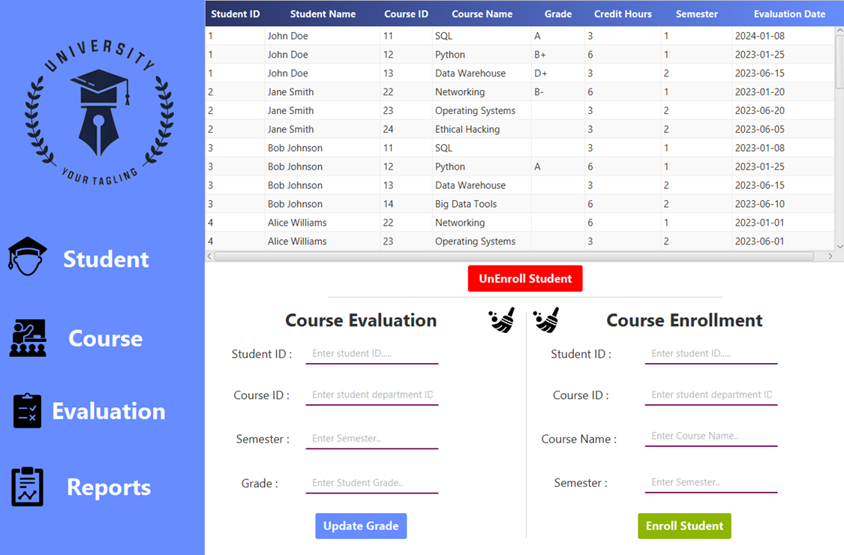

Slide 16
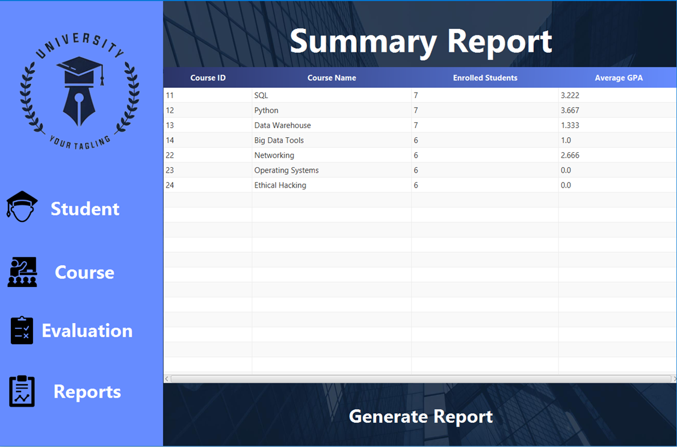

Slide 17
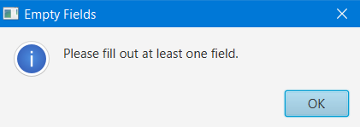
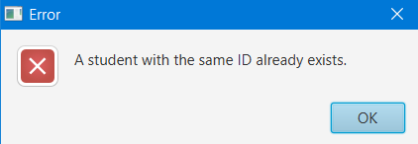
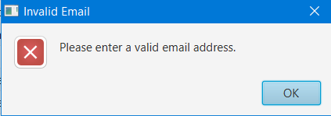
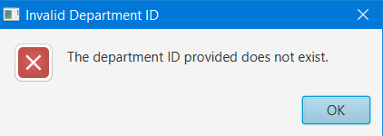
Validation Checks
Handling Empty Fields
Handling Primary Keys Repetition
Handling E-mail Format
Handling Invalid Department ID

Slide 18
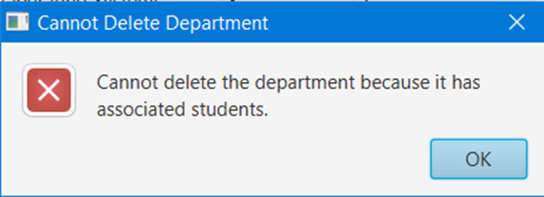
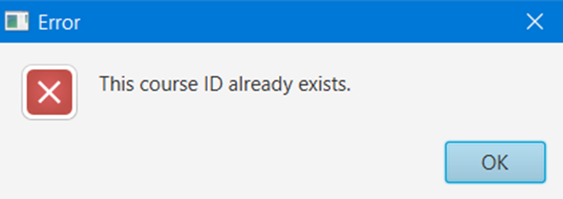
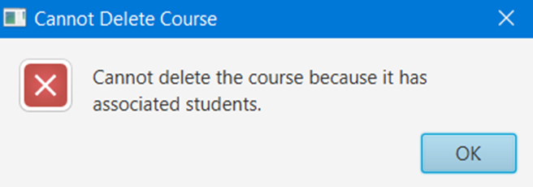
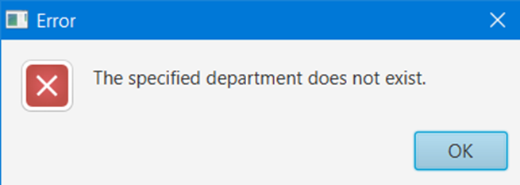
Validation Checks
Handling Deleting Department with Enrolled Students
Handling Adding Existing Course ID
Handling Deleting Course with Enrolled Students
Handling Adding Course to Non-Existing Department

Slide 19
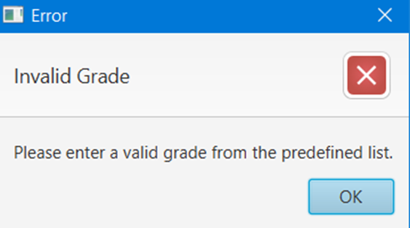
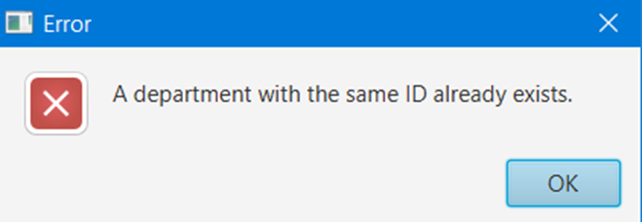
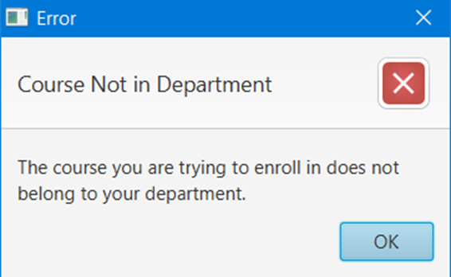
Validation Checks
Handling Adding Department with Same ID
Handling Invalid Grades
Handling Enrolling Student into a Course not in his Department

Slide 20
Human resources slide 10
Thank You

